Slide 1
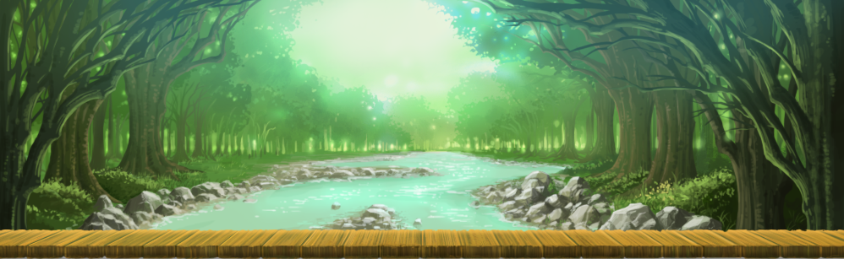
Sage Trials

Slide 2
What is a role Playing Game?
A Role Playing Game puts the player in control of at least one other character, and they become that character.
A Role Playing Game provides a world to explore
Through this, players have a place in the narrative

Slide 3
INSPIRATION

Slide 4
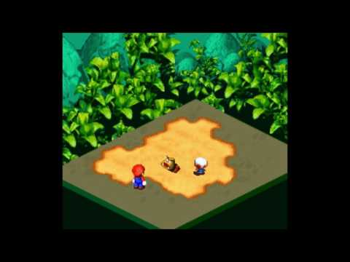

Slide 5
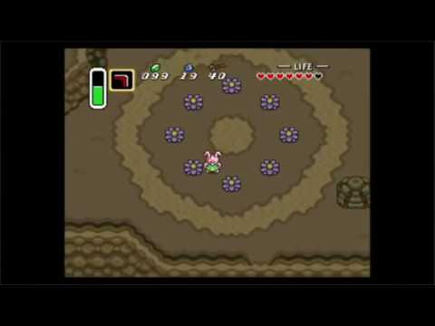

Slide 6
DISCOVERY

Slide 7
TOOLS
Photoshop
RPG Maker MV
RESOURCES
RPG Maker Forums
Reddit
Youtube Tutorials
Deviant Art
Friends

Slide 8
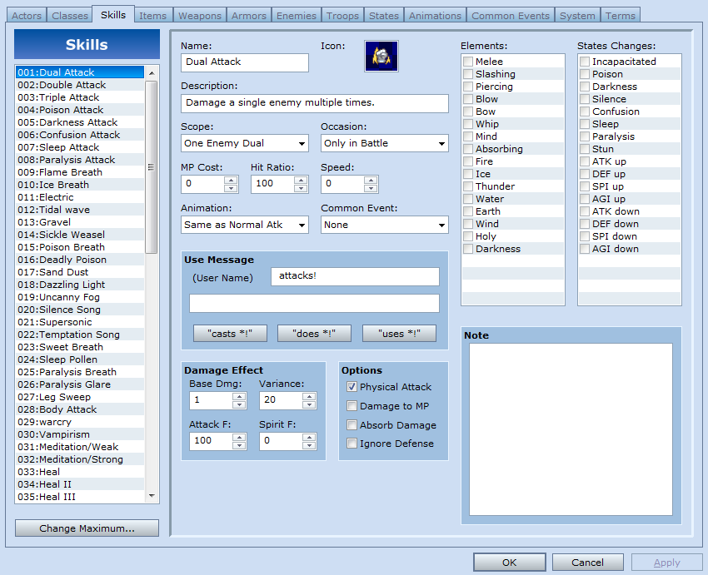

Slide 9
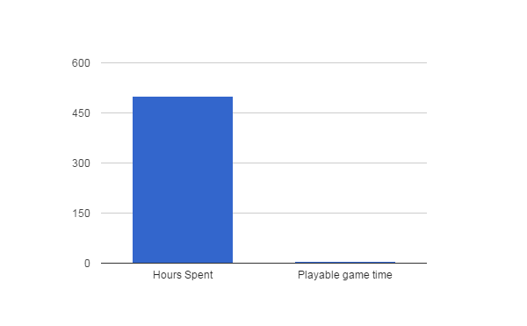
creation time vs gameplay time
100 hours of work corresponds to 1 hour of in game play time
This time is spent:
Creating Art
Scripting Events
Designing gameplay elements
Implementing combat
Enemy design
Creating equipment
Level design
Story writing
Mapping

Slide 10
Project Challenges
Creating Maps and learning to use Art assets
Learning how to implement and edit plugins
New Technology
RPG Maker MV
Photoshop
Scripting in MV
Java
Foreign API

Slide 11
Term Goals

Slide 12
Create some Maps
Finalize Story
Design Characters
Research puzzles and mechanics
Implement intro and tutorial level

Slide 13
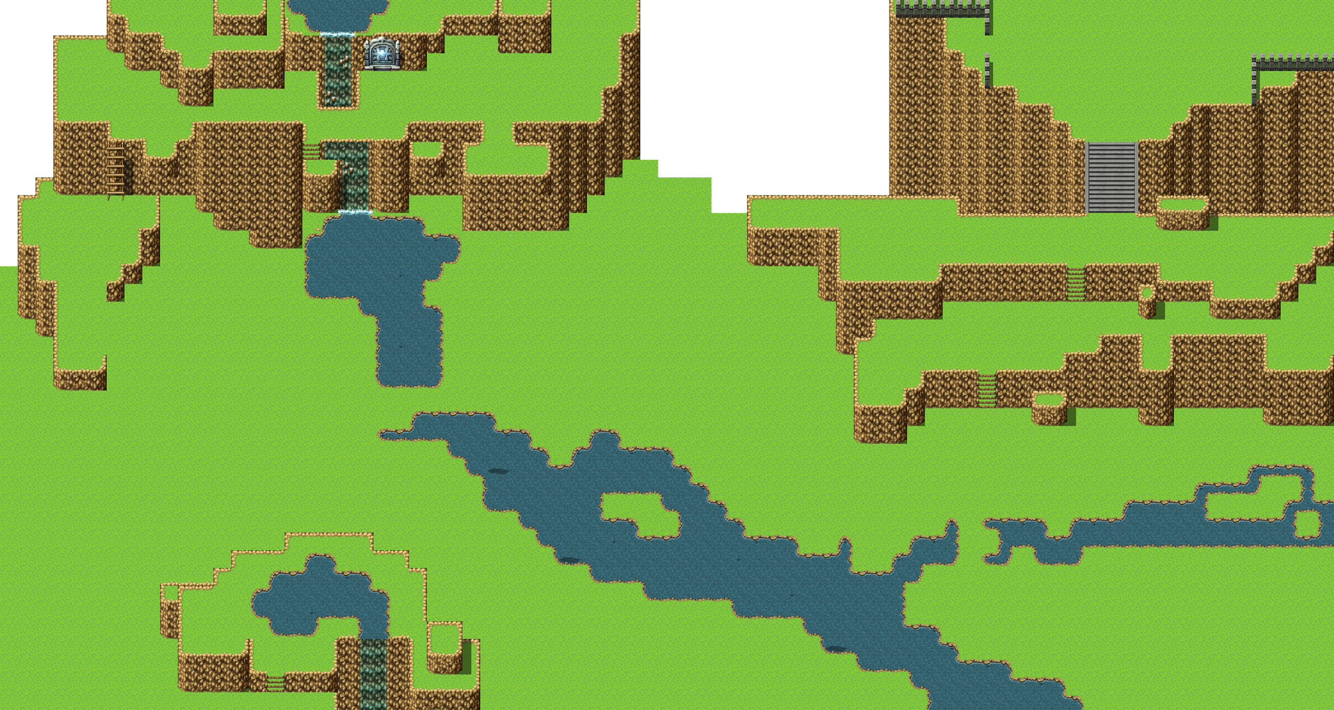

Slide 14
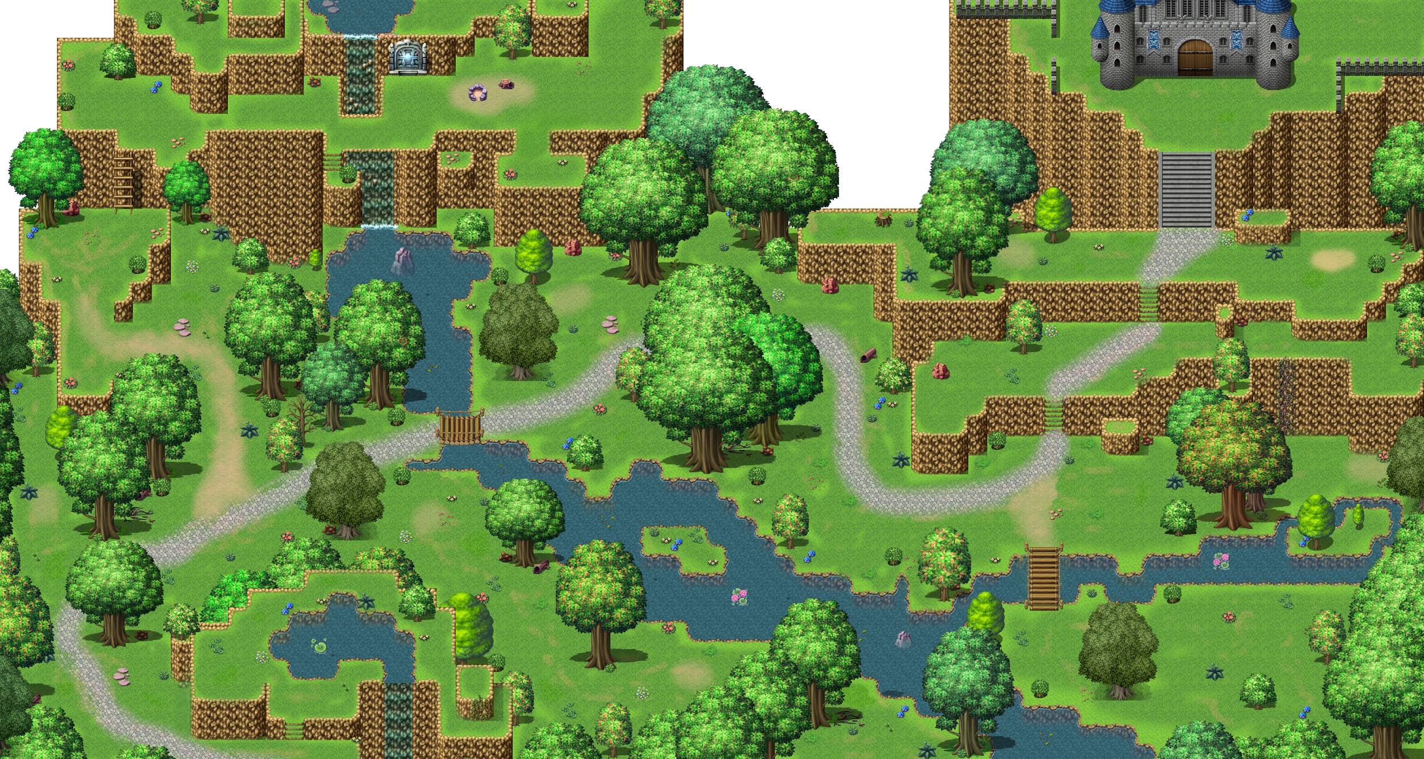

Slide 15
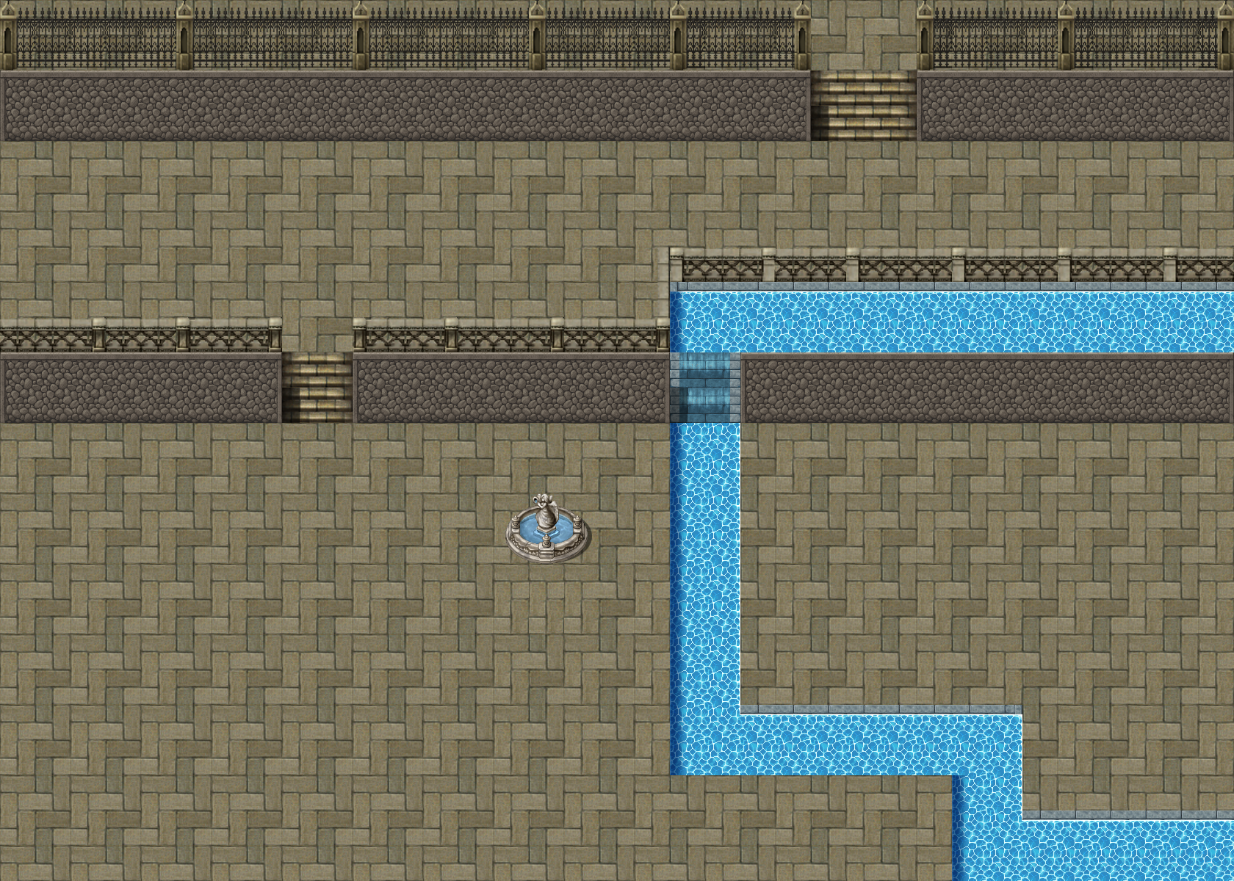

Slide 16
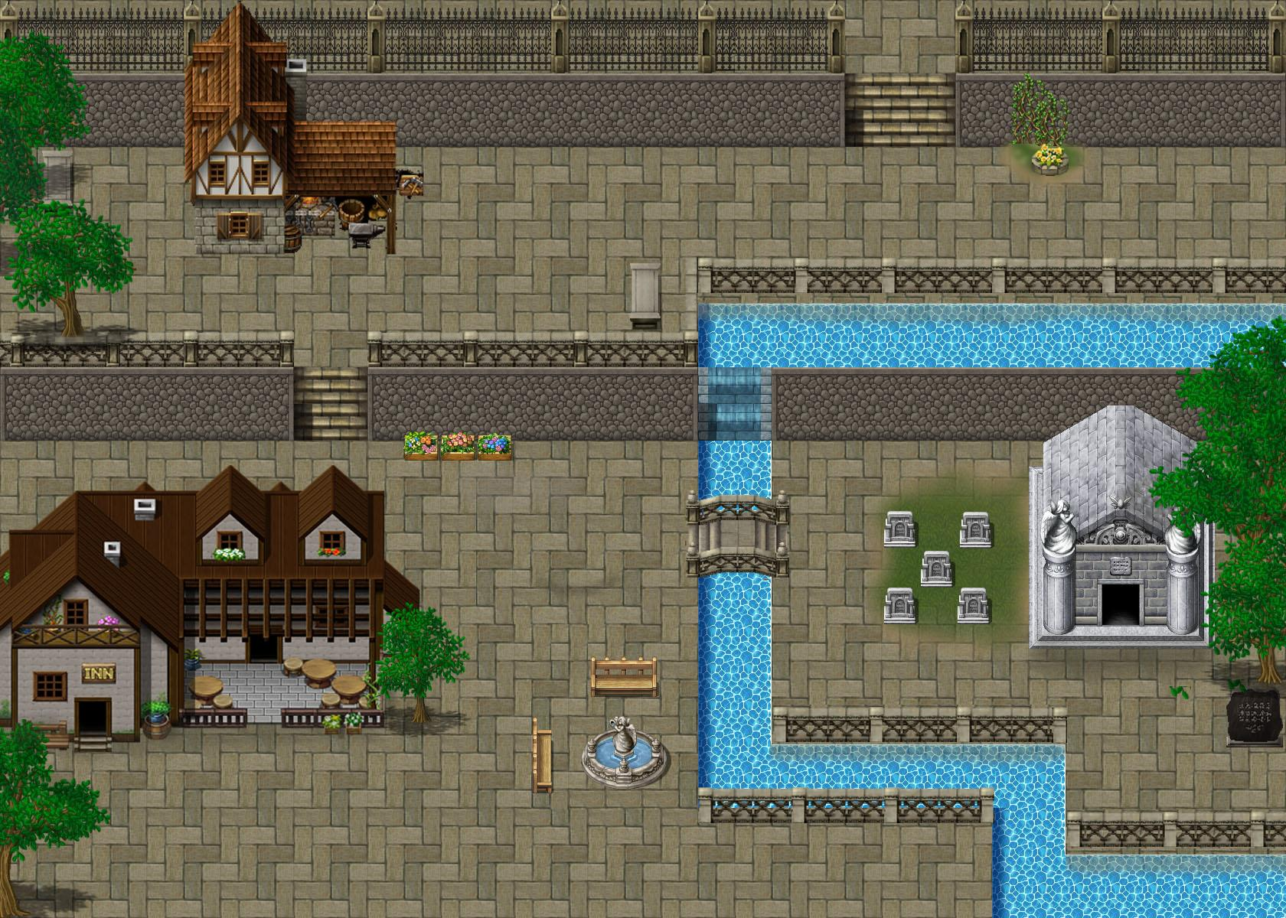

Slide 17
What went well
Character design
Level design
Art direction
Story design

Slide 18
What did not go well?
Time management
Initial attempts at creating maps.

Slide 19
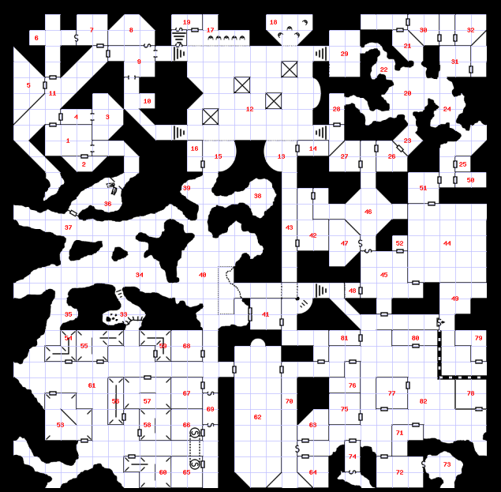
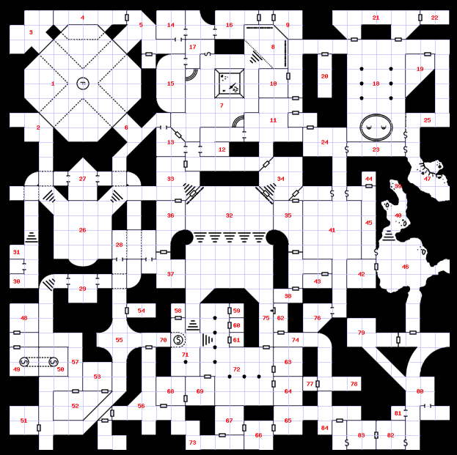

Slide 20
ROAD MAP

Slide 21
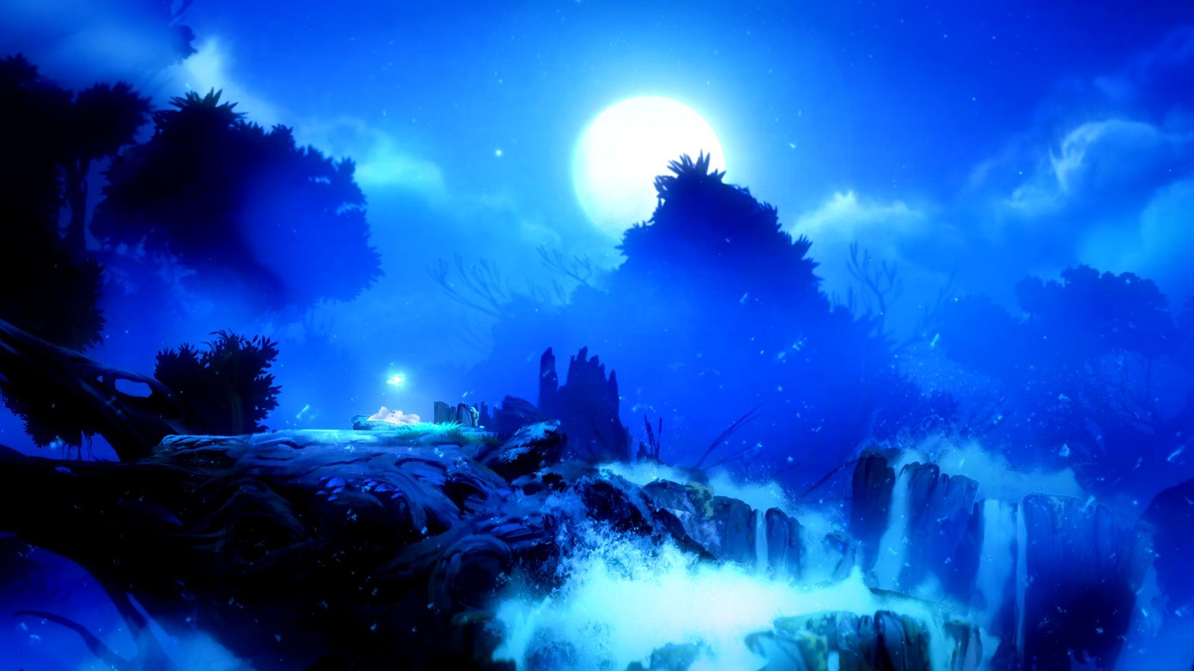
THANKS!
Any questions?
justin.obrien@oit.edu

